Slide 1
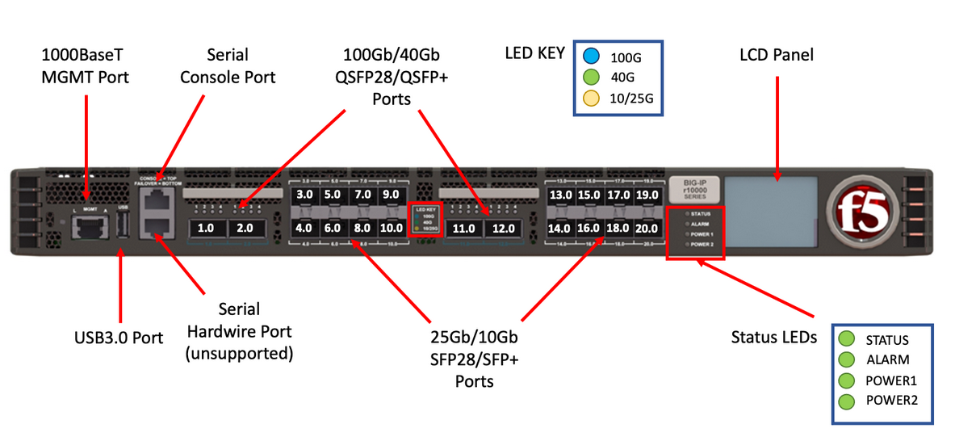
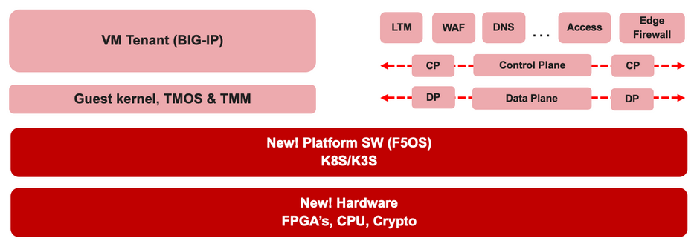

F5 rSeries Learning with
Alexander S

Slide 2
Agenda →
  iSeries to rSeries
  F5OS Basic Setup
  F5OS Upgrade Procedure
  VLAN and LAG Configuration
    Configure VLANs
    Configure LAG (Link Aggregation Group)
    Assign VLANs to the LAG
  Tenant OS Deployment Preparation
  Tenant OS Deployment
  rSeries Tenant Basic Setup
  High Availability (HA) in rSeries Tenants
    Best Practices for rSeries Tenant HA
    rSeries Tenant HA Configuration

Slide 3
Chapter 5 – Tenant OS deployment Preparation

Slide 4
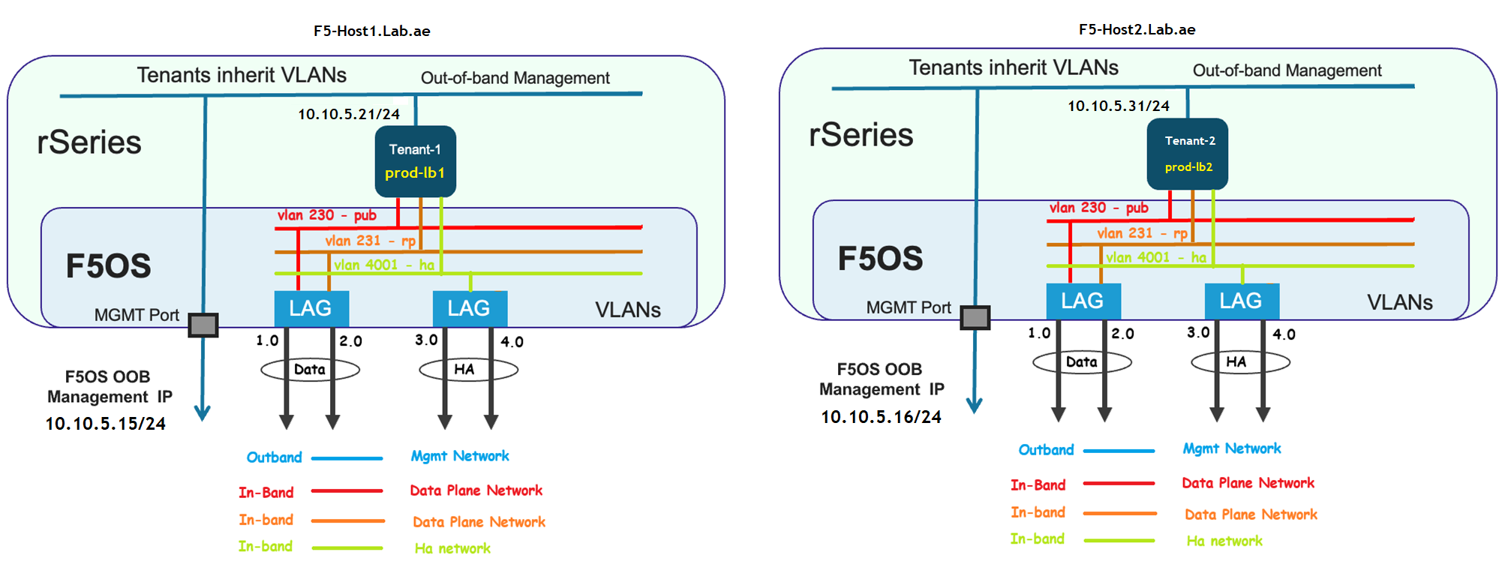
Chapter 5 – Tenant OS deployment Preparation
1. Tenant Names and Management IP Addresses

Slide 5

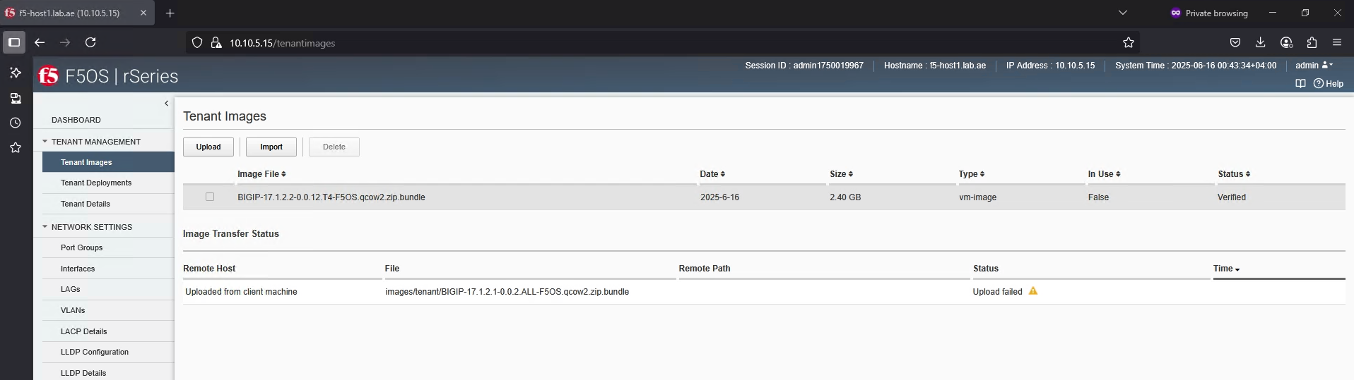

Chapter 5 – Tenant OS deployment Preparation
2. Download and Import the tenant OS
Download and Import the tenant OS (Done this at chapter 3)
The tenant OS is now available on both rSeries hosts.
  TMOS Download

Slide 6
Chapter 5 – Tenant OS deployment Preparation
3. Tenant Networking Layer – DATA LAG – Done this at Chapter 4
DATA LAG
  Assigned with vlan 230 for client side
  Assigned with vlan 231 for server side

Slide 7
Chapter 5 – Tenant OS deployment Preparation
3. Tenant Networking Layer – HA LAG – Done this at Chapter 4
HA LAG
  Assigned with vlan 4001 for high availability

Slide 8
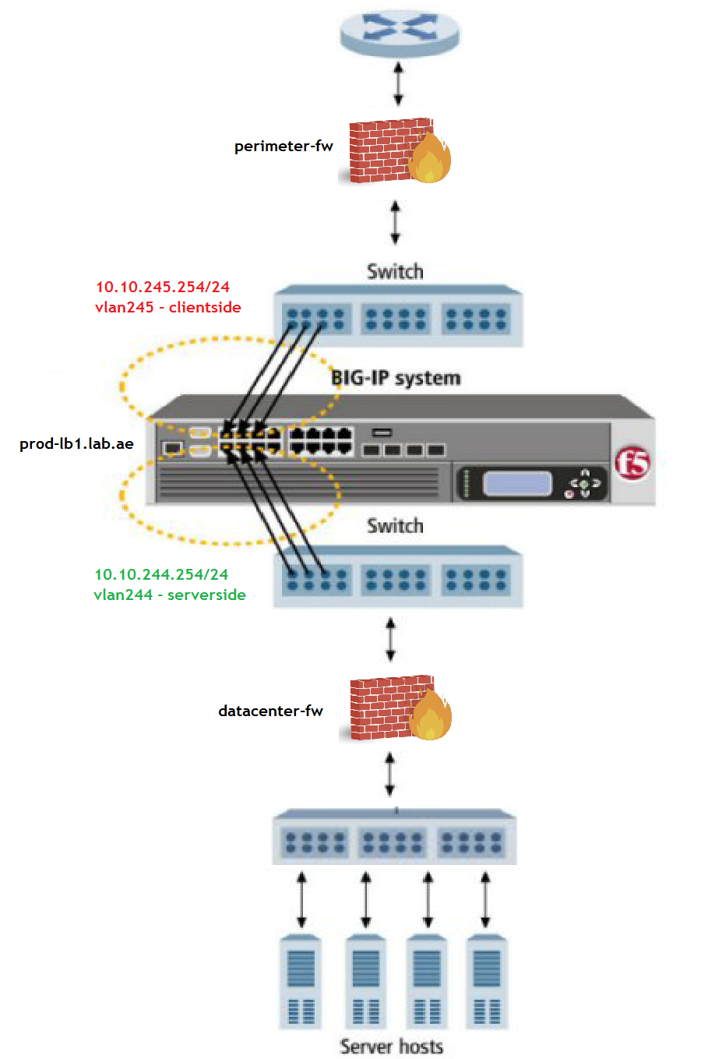
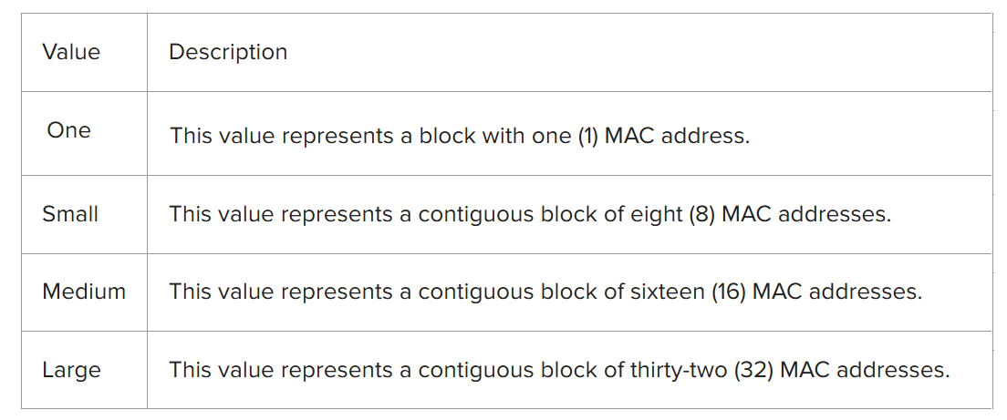
Chapter 5 – Tenant OS deployment Preparation
4. Tenant MAC Block Size
How many unique MAC addresses are available for use within a tenant
🔍 Important Notes
The number of virtual servers you can configure is not directly limited by the MAC block size.
In standard routed mode deployments, multiple virtual servers can share the same MAC address assigned to the tenant’s interfaces.

Slide 9
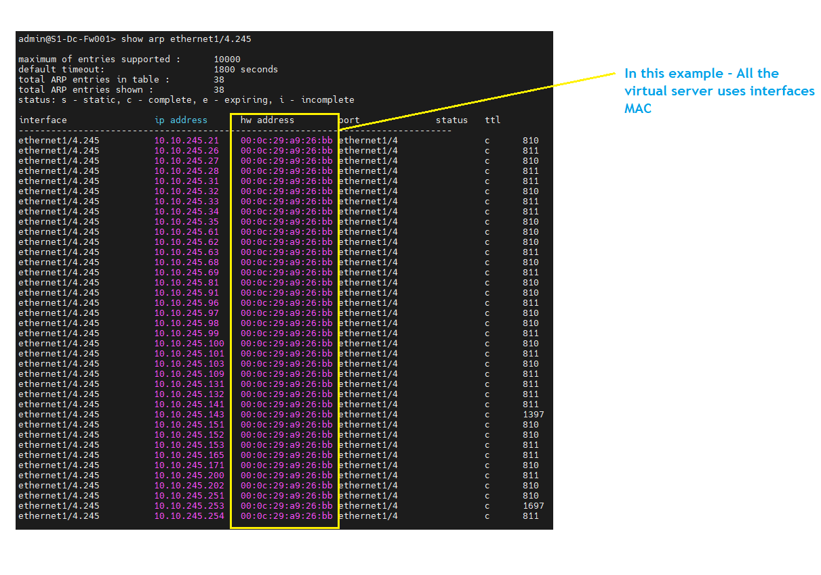
Chapter 5 – Tenant OS deployment Preparation
4. Tenant MAC Block Size – All the virtual servers uses interface MAC

Slide 10
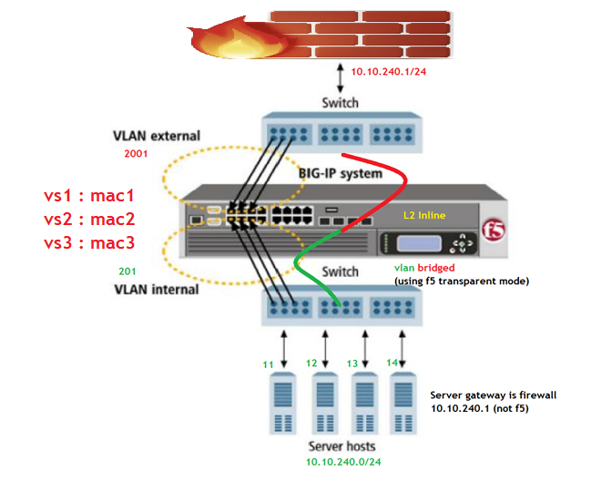
Chapter 5 – Tenant OS deployment Preparation
4. Tenant MAC Block Size – L2 inline mode need a unique MAC for each vs

Slide 11
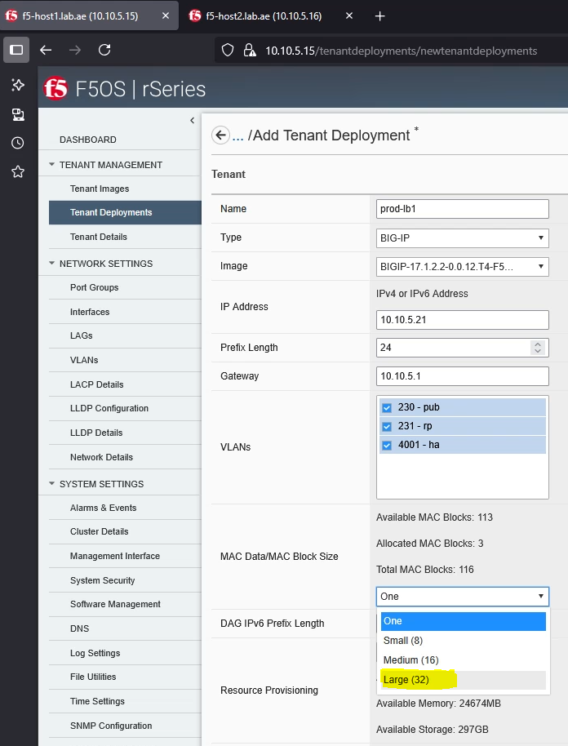
Chapter 5 – Tenant OS deployment Preparation
4. Tenant MAC Block Size – Always assign Large for production
Always choose Medium or Large MAC block sizes for production.
There is no negative impact or resource loss.
Larger MAC block provides more flexibility for scaling virtual servers.

Slide 12
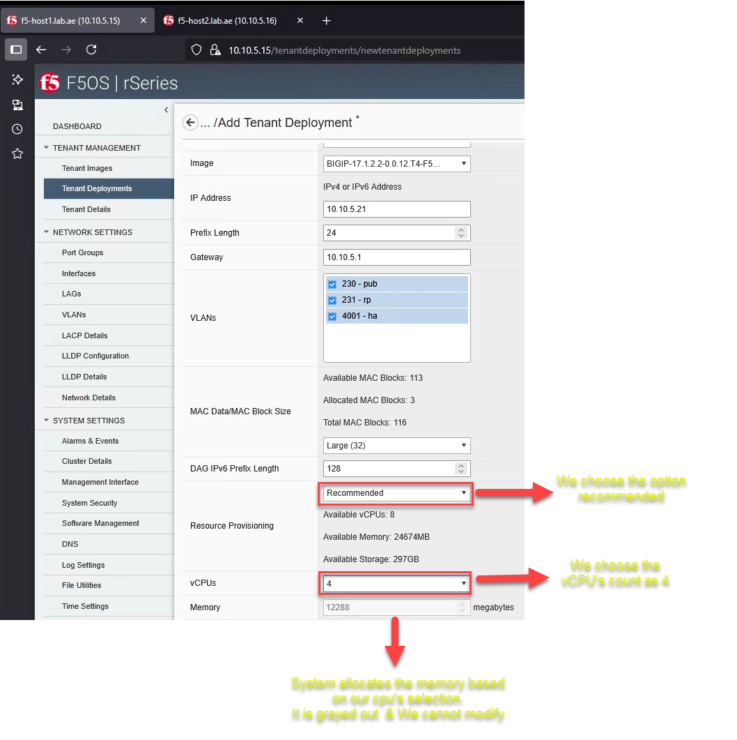
Chapter 5 – Tenant OS deployment Preparation
5. Resource Provisioning – Recommend / Advanced
Recommended
  DRAM allocation done by system based on vCPU selection.
  No flexibility to manually adjust DRAM allocation.

Slide 13
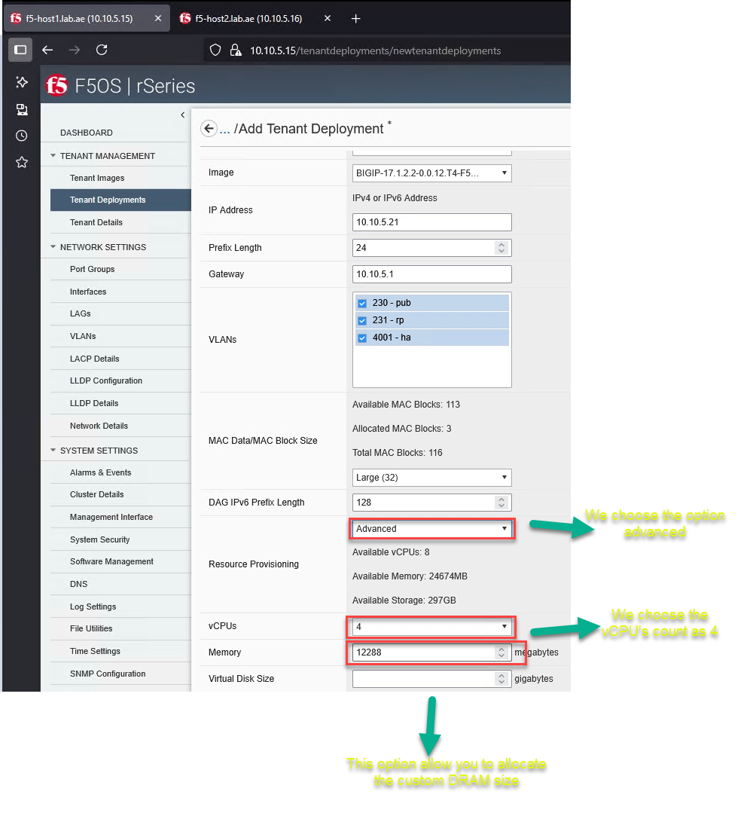
Chapter 5 – Tenant OS deployment Preparation
5. Resource Provisioning – Recommend / Advanced
Advanced
  Provides the option to manually configure both vCPUs and DRAM, allowing customization beyond the default recommendations.

Slide 14
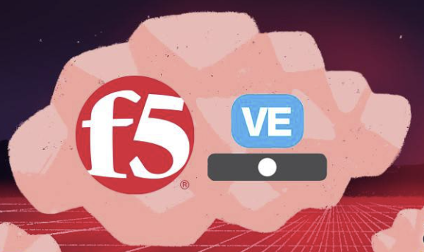




Chapter 5 – Tenant OS deployment Preparation
6. Understanding and Changing Tenant Deployment State
Tenant’s settings and parameters are defined and saved in the F5OS
Configured
Provisioned
Deployed
No resources allocated
Only for the initial deployment
Settings & Parameters
System resources such as vCPU, memory, and disk space are allocated to the tenant.
CPU, DRAM and HDD assigned
CPU, DRAM and HDD assigned
The tenant is active and running. It is utilizing the allocated CPU, memory, and virtual disk to perform its intended functions.
System is active

Slide 15

Chapter 5 – Tenant OS deployment Preparation
6. Understanding and Changing Tenant Deployment State
Configured
(Initial deployment)
Settings & Parameters
Stop the tenant
Delete the tenant’s virtual disk
(Delete the BIGIP configuration)
Release system resources.
Release system resources.
Don’t change provisioned to configured
(Reset the configuration and run time status!!)
Don’t change deployed to configured
Deployed
CPU, DRAM and HDD assigned
Provisioned
System is active
CPU, DRAM and HDD assigned

Slide 16
Chapter 5 – Tenant OS deployment Preparation
6. Understanding and Changing Tenant Deployment State
Tenant’s settings and parameters are defined and saved in the F5OS
Configured
Provisioned
Deployed
No resources allocated
Only for the initial deployment
Settings & Parameters
System resources such as vCPU, memory, and disk space are allocated to the tenant.
Tenant is not active!
CPU, DRAM and HDD assigned
CPU, DRAM and HDD assigned
The tenant is active and running. It is utilizing the allocated CPU, memory, and virtual disk to perform its intended functions.
System is active

Slide 17


Chapter 5 – Tenant OS deployment Preparation
6. Understanding and Changing Tenant Deployment State
Gracefully shut down the running tenant.
Preserve the virtual disk and all configuration data.
During the host upgrade
CPU, DRAM and HDD assigned
Deployed
Provisioned
System is active
CPU, DRAM and HDD assigned
Allowing the tenant to be restarted later without reconfiguration

Slide 18
Chapter 5 – Tenant OS deployment Preparation
6. Understanding and Changing Tenant Deployment State
Tenant’s settings and parameters are defined and saved in the F5OS
Configured
Provisioned
Deployed
No resources allocated
Only for the initial deployment
Settings & Parameters
System resources such as vCPU, memory, and disk space are allocated to the tenant.
Tenant is not active!
CPU, DRAM and HDD assigned
CPU, DRAM and HDD assigned
The tenant is active and running. It is utilizing the allocated CPU, memory, and virtual disk to perform its intended functions.
System is active

Slide 19
Chapter 5 – Tenant OS deployment Preparation
6. Understanding and Changing Tenant Deployment State
Configured
(Initial deployment)
Settings & Parameters
Resources are allocated and the tenant starts
Deployed
System is active
CPU, DRAM and HDD assigned
The tenant starts using already-allocated resources.
CPU, DRAM and HDD assigned
Provisioned

Slide 20
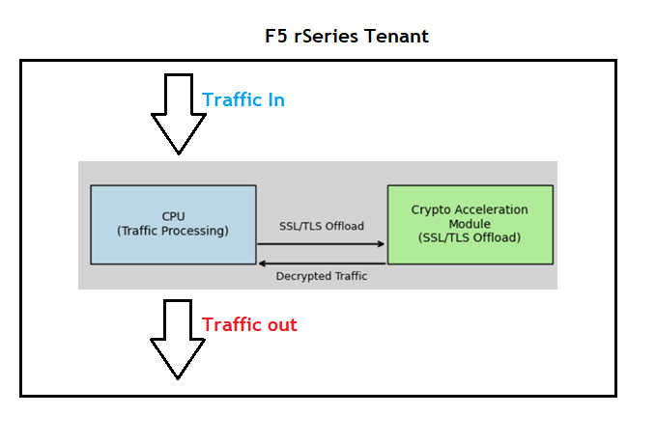
Chapter 5 – Tenant OS deployment Preparation
7. Enabling Crypto Acceleration
Improves Cryptographic Speed and Efficiency on F5 rSeries
CPU handles general traffic processing
CPU offloads SSL/TLS decryption encryption to Crypto Acceleration Module.
Traffic Flow:
  Encrypted traffic enters the appliance
  SSL/TLS is offloaded to the crypto module
  Decrypted traffic is returned to the CPU for further processing
  Clean traffic exits to internal services
  Must enable Crypto Acceleration

Slide 21
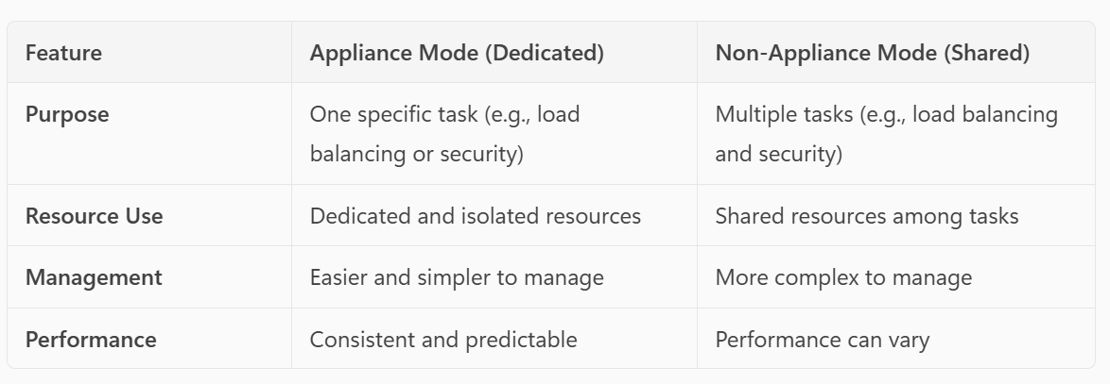
Chapter 5 – Tenant OS deployment Preparation
8. Appliance mode
Appliance mode
Tenant is designed to perform a specific task. For example this tenant does the WAF protection.
Key - Dedicated resources assigned to that tenant regardless of the usage.
Non Appliance Mode
Tenant is designed to perform more tasks like LTM, ASM and APM.
Key - Shared resources assigned to the tenant.
WAF
(Resource dedicated)
ADC – LTM+WAF+APM
(Resource shared between the modules)

Slide 22
Please continue by watching the next video.
Next video is – Tenant OS Deployment – Thank you!!!

